Slide 1
Renewable Energy and Global Economies
Jared Beaulieu, Neel Arvind Desai, Rawad Maiteh, Dev Shah

Slide 2
Agenda
01
02
03
04
05
Introduction
Findings
Combining Data Sources
Timeline
Project Objective
Kaggle/ USGS
UN Data
World Bank
IEA
06
Proposal Design of Final Dashboard
Limitations and Future Work
Visualizations
Visualization 1
Visualization 2
Visualization 3

Slide 3
01 Project Timeline
Week 1
Check In on basic research
Week 2
Research Collected & Compiled
Week 3
Goal for cleaning data
Week 4
Visualizations & Write-Up Draft
Week 5
Project Completion

Slide 4
01 Project Objective
Hypothesis:
A higher GDP leads to a higher percentage of renewable energy production.
Geopolitics and economic factors significantly influence renewable energy production in a country.
Set of questions that we seek answers for:
Does the economic growth/ GDP of a country influence its renewable energy production?
How does a country’s population affect the production of its renewable energy?
What is the general percentage trend of renewable production vs non-renewable production?
How do education and public awareness affect the amount of renewable energy production in a country?
What role does the geography of a location play in determining the type of renewable energy that can be deployed?
How much of a country's energy budget goes towards each type of energy production?

Slide 5



02 Findings
GDP plays a major role in the renewable energy production.
Population and education are associated with renewable energy output, but not necessarily driving factors. Geography may play a role with some energy production, but does not seem significant.
There is a great amount of relation between the multiple variables, but more thorough statistical analysis would be needed for conclusive findings.

Slide 6








03 Combining Data Sources
Data Cleaning
Combining Data

Slide 7
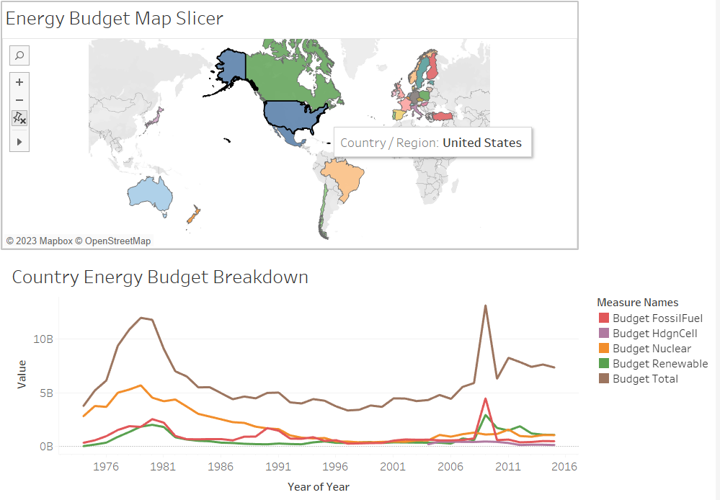
04 Visualization 1
Question:
How much of a country's energy budget goes towards each type of energy production?
Answer:
Country comparison (within IEA affiliation) selection on map
Shifts over time, but budget to energy is not explicit
Specific events, such as 2008 World economic crisis have impact

Slide 8
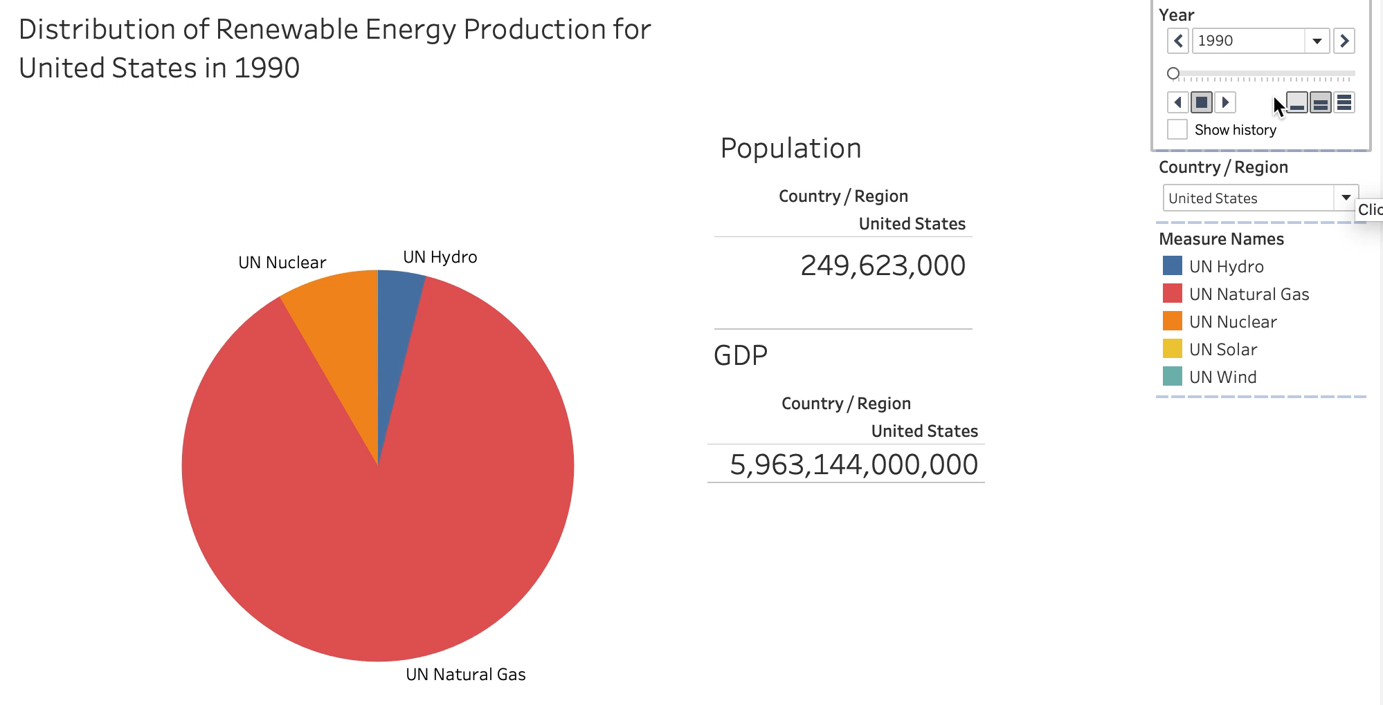
04 Visualization 2
Questions:
Does the economic growth/ GDP of a country influence its renewable energy production?
How does a country’s population affect the production of its renewable energy?
Answer:
Overall decrease proportion of natural gas
Increase in wind and solar energy production
Steady use of hydro
Nuclear relatively proportionally with population
GDP allows for increase in renewable energy production

Slide 9
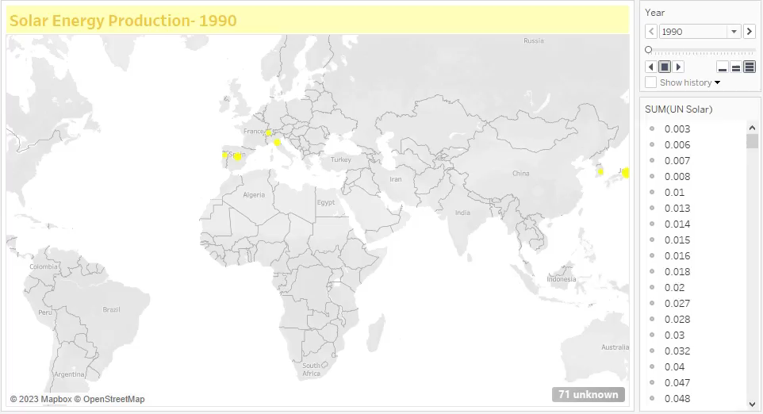
04 Visualization 3
Provides a dashboard to show the Solar energy Production by different countries over the years from 1965 – 2020
Question:
What role does the geography of a location play in determining the type of renewable energy that can be deployed?
Answer:
Percentage, growth throughout the years
Economy more of factor than geography

Slide 10
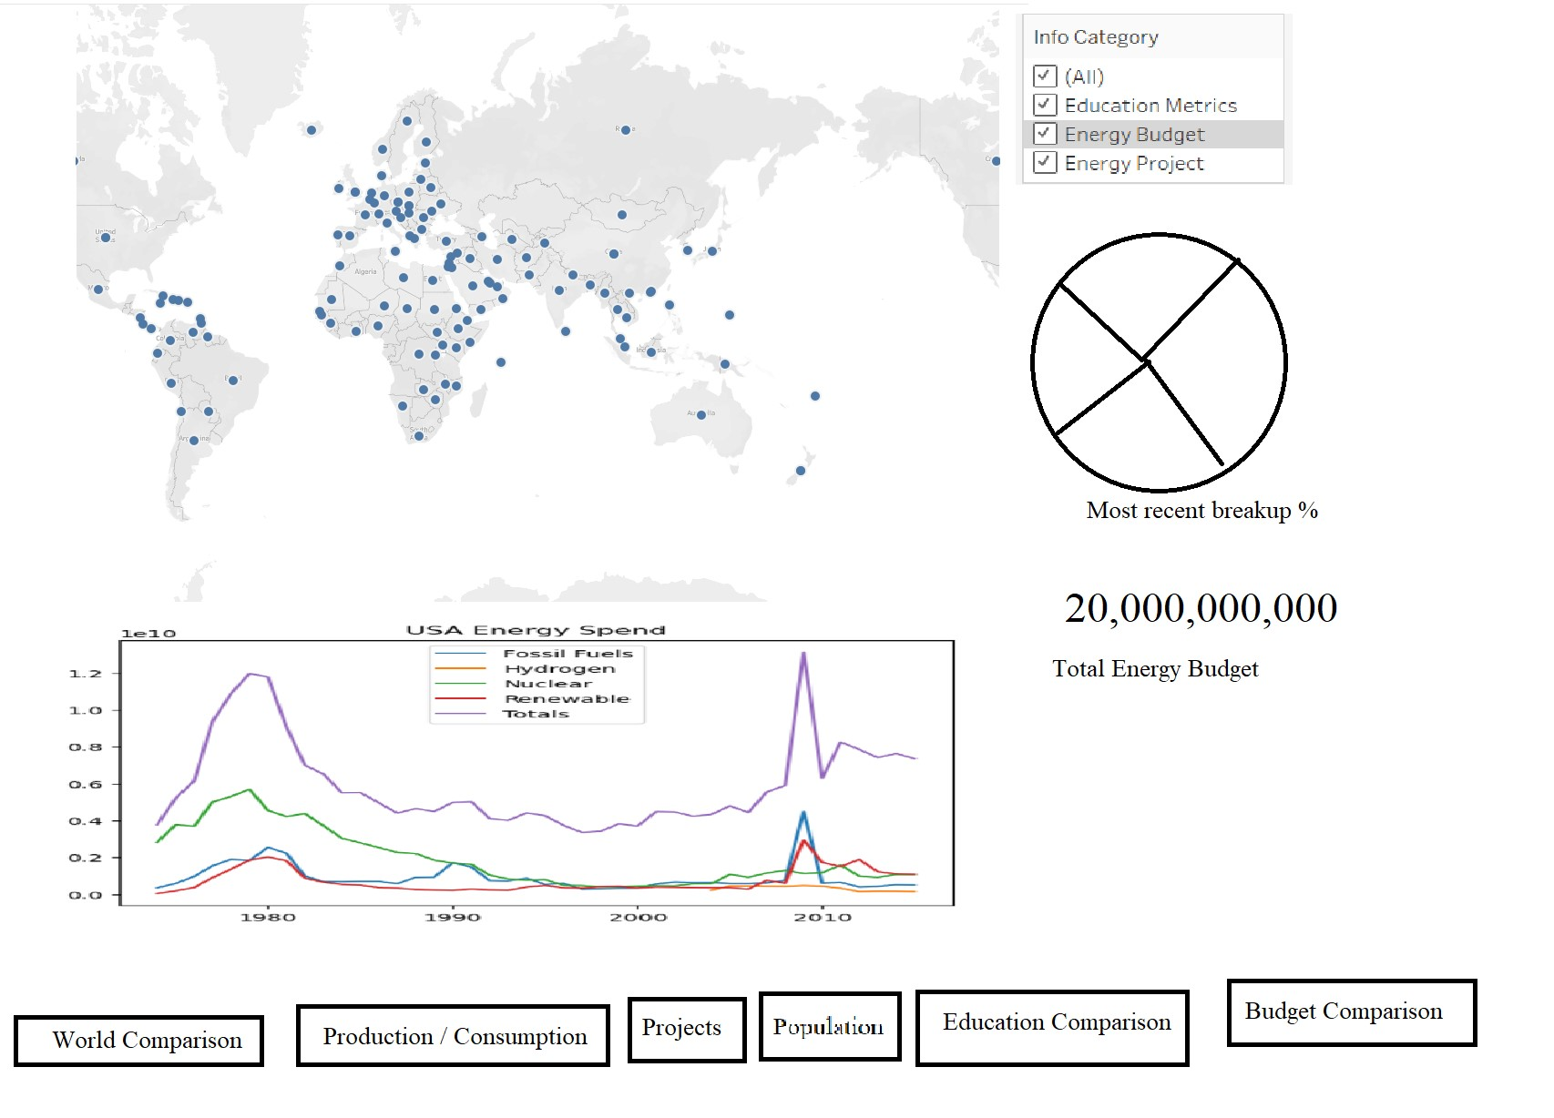
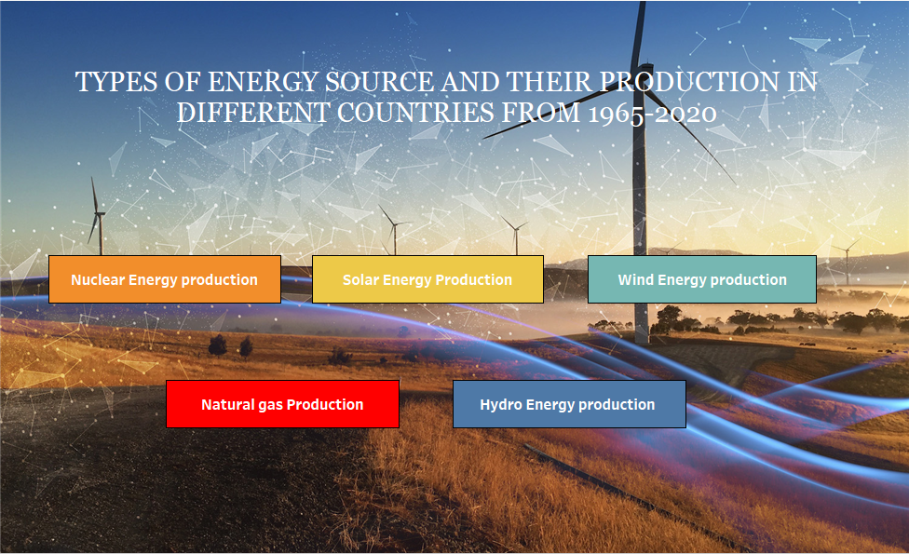
05 Proposal Design of Final Dashboard
Home Page
Navigate to sub-screens with energy source type map, showing growth over years
Ability to filter by country

Slide 11
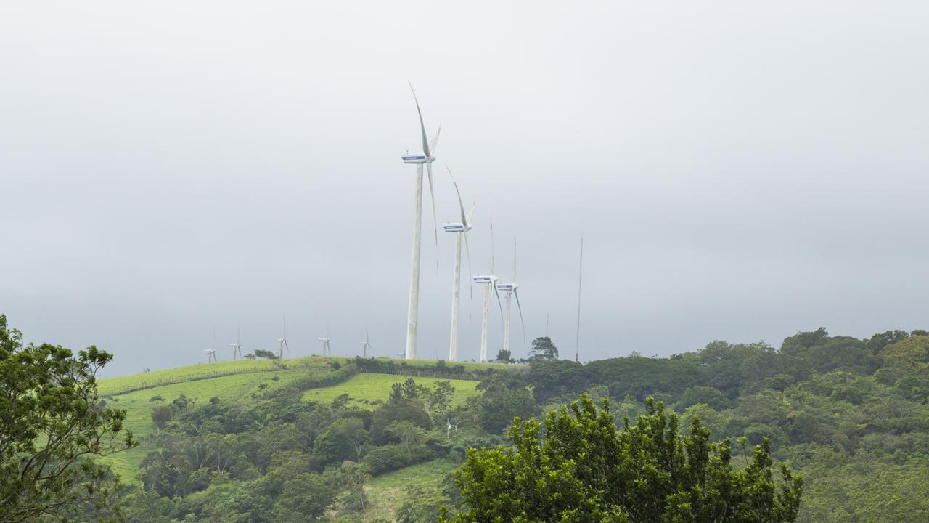
06 Limitations and Future Work
Limitations:
Data Availability
Correlation does not mean Causation
Some Factors were not covered
Future Work:
Research other factors including government policies, technological advancements
Forecasting and trend analysis
Public Perception and behavior studies/surveys
Case studies
Notes:
Limitations:
limitations on factors that contribute or otherwise explain Renewable Energy growth
such as Patents, Nuclear Energy material deposits, types of economies, industrialization
future could do better at forecasting, analyzing trends themselves in addition to the comparing information associations / correlations (regression?)
links to sources in Dashboard
Sustainable Development Goals
down to a micro-level, a city or town potentially in some of these countries (particularly ones where we might be from)
Future Work:

Slide 12
Thank You!

Slide 13
Citations
[1] “Education statistics - all indicators,” DataBank, https://databank.worldbank.org/source/education-statistics-%5E-all-indicators#
[2] Iea, “CCUS projects database - data product,” IEA, https://www.iea.org/data-and-statistics/data-product/ccus-projects-database
[3] Iea, “Energy Technology RD&D budgets - data product,” IEA, https://www.iea.org/data-and-statistics/data-product/energy-technology-rd-and-d-budget-database-2
[4] “Population, total,” World Bank Open Data, https://data.worldbank.org/indicator/SP.POP.TOTL
[5] “Undata | Explorer,” United Nations, http://data.un.org/Explorer.aspx
Notes:
MLA Format

